Slide 1
E-BANKING SERVICES

Slide 2
OBJECTIVE:
The main objective of the proposed solution is to be automated the various functions and activities of the bank through Internet. The solution will facilitate to the bank employees and the account holders with the different modules. This solution is very much necessary for the private sector banks and the corporate sector. The banking industry will take a new shape and explore like never before. Using the solution the bankers and account holders can generate various kinds of reports.

Slide 3
Modules:
This application consists following modules:
Admin module
User module
Bill payment Module
Reports Module

Slide 4
Admin Module:
This module is belongs to bank staff. By using this module Administrator can add type of accounts (saving and current etc), minimum deposit amount in that particular account, interest rate and period of time.

Slide 5
User Module:
This module is all about customers of a bank. By using this module customers can go for different operations like they can apply for a new account in a bank, they can apply for different loans based on their requirement and also they can view their personal information, modify both personal and login information etc. Following operations can be done by any customer.

Slide 6
New Account: Customer can open a new account.
Teller Services: Customer can apply for a new debit card
Transaction Details: Customer can transfer his funds to other accounts and also they can pay tax to govt.
Requests: By using this functionality customer can go for different type of transactions on drafts and cheque(s).
Maintenance Services: Either customers can close their accounts or they can modify their information.
User Alerts: Customer can pay credit card amount to that bank.

Slide 7
Bill Payment Services:
Customer can pay bills like electricity bill, telephone bill etc through his account.

Slide 8
Reports Module:
In this module administrator will get different types of reports regarding
customers like Number of customers of this portal etc. And this module is
controlled by administrator only.
Accounts
Card Transactions
Cheque reorder
Credit cards
Customers
Draft cheque
Funds Transfer
Nominee Details
Tax Payments
Bill Payments

Slide 9
Software requirements:
Operating System : Windows
Technology : Java/j2ee (JDBC, Servlets, JSP)
Web Technologies : Html, JavaScript, CSS
IDE : My Eclipse
Web Server : Tomcat
Database : Oracle
Software’s : J2SDK1.5, Tomcat 5.5, Oracle 9i

Slide 10
Hardware requirements:
Hardware : Pentium based systems with a minimum of p4
RAM : 256MB (minimum)

Slide 11
SYSTEM REQUIREMENT SPECIFICATION

Slide 12
Modules:
This application consists following modules:
Admin module
User module
Bill payment Module
Reports Module
Module description
1. Admin Module:
This module is belongs to bank staff. By using this module Administrator can add type of accounts (saving and current etc), minimum deposit amount in that particular account, interest rate and period of time.
2.User Module:
This module is all about customers of a bank. By using this module customers can go for different operations like they can apply for a new account in a bank, they can apply for different loans based on their requirement and also they can view their personal information, modify both personal and login information etc. Following operations can be done by any customer.

Slide 13
New Account: Customer can open a new account.
Teller Services: Customer can apply for a new debit card
Transaction Details: Customer can transfer his funds to other accounts and also they can pay tax to govt.
Requests: By using this functionality customer can go for different type of transactions on drafts and cheque(s).
Maintenance Services: Either customers can close their accounts or they can modify their information.
User Alerts: Customer can pay credit card amount to that bank.
3. Bill Payment Services:
Customer can pay bills like electricity bill, telephone bill etc through his account.
4. Reports Module:
In this module administrator will get different types of reports regarding customers like Number of customers of this portal etc. And this module is controlled by administrator only.

Slide 14
Accounts
Card Transactions
Cheque reorder
Credit cards
Customers
Draft cheque
Funds Transfer
Tax Payments
Bill Payments

Slide 15
FEASIBILITY STUDY

Slide 16
TECHNICAL FEASIBILITY:
Evaluating the technical feasibility is the trickiest part of a feasibility study. This is because, at this point in time, not too many detailed design of the system, making it difficult to access issues like performance, costs on (on account of the kind of technology to be deployed) etc. A number of issues have to be considered while doing a technical analysis.
Understand the different technologies involved in the proposed system
Find out whether the organization currently possesses the required technologies
Operational Feasibility:
Proposed project is beneficial only if it can be turned into information systems that will meet the organizations operating requirements. Simply stated, this test of feasibility asks if the system will work when it is developed and installed. Are there major barriers to Implementation? Here are questions that will help test the operational feasibility of a project:Is there sufficient support for the project from management from users? If the current system is well liked and used to the extent that persons will not be able to see reasons for change, there may be resistance.

Slide 17
Economic Feasibility:
Economic feasibility attempts 2 weigh the costs of developing and implementing a new system, against the benefits that would accrue from having the new system in place. This feasibility study gives the top management the economic justification for the new system.

Slide 18
DATA FLOW DIAGRAMS

Slide 19
A graphical tool used to describe and analyze the moment of data through a system manual or automated including the process, stores of data, and delays in the system. Data Flow Diagrams are the central tool and the basis from which other components are developed. The transformation of data from input to output, through processes, may be described logically and independently of the physical components associated with the system. The DFD is also know as a data flow graph or a bubble chart.
Dataflow: Data move in a specific direction from an origin to a destination.
Process: People, procedures, or devices that use or produce (Transform) Data. The physical component is not identified.
Source: External sources or destination of data, which may be People, programs, organizations or other entities.
Data Store: Here data are stored or referenced by a process in the System.

Slide 20
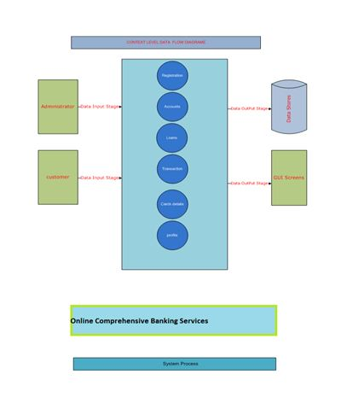
CONTEXT LEVEL DIAGRAM

Slide 21
1. ADMINISTRATOR
AUTHENTICATION DFD:

Slide 22
LEVEL-2:

Slide 23
SDLC METHODOLOGIES

Slide 24
This document play a vital role in the development of life cycle (SDLC) as it describes the complete requirement of the system. It means for use by developers and will be the basic during testing phase. Any changes made to the requirements in the future will have to go through formal change approval process.
SPIRAL MODEL was defined by Barry Boehm in his 1988 article, “A spiral Model of Software Development and Enhancement. This model was not the first model to discuss iterative development, but it was the first model to explain why the iteration models.
The steps for Spiral Model can be generalized as follows:
The new system requirements are defined in as much details as possible. This usually involves interviewing a number of users representing all the external or internal users and other aspects of the existing system.
A preliminary design is created for the new system.
A first prototype of the new system is constructed from the preliminary design. This is usually a scaled-down system, and represents an approximation of the characteristics of the final product.

Slide 25
A second prototype is evolved by a fourfold procedure:
Evaluating the first prototype in terms of its strengths, weakness, and risks.
Defining the requirements of the second prototype.
Planning an designing the second prototype.
Constructing and testing the second prototype.
Risk factors might involved development cost overruns, operating-cost miscalculation, or any other factor that could, in the customer’s judgment, result in a less-than-satisfactory final product.
The existing prototype is evaluated in the same manner as was the previous prototype, and if necessary, another prototype is developed from it according to the fourfold procedure outlined above.
The preceding steps are iterated until the customer is satisfied that the refined prototype represents the final product desired.
The final system is constructed, based on the refined prototype.
The final system is thoroughly evaluated and tested. Routine maintenance is carried on a continuing basis to prevent large scale failures and to minimize down time.

Slide 26
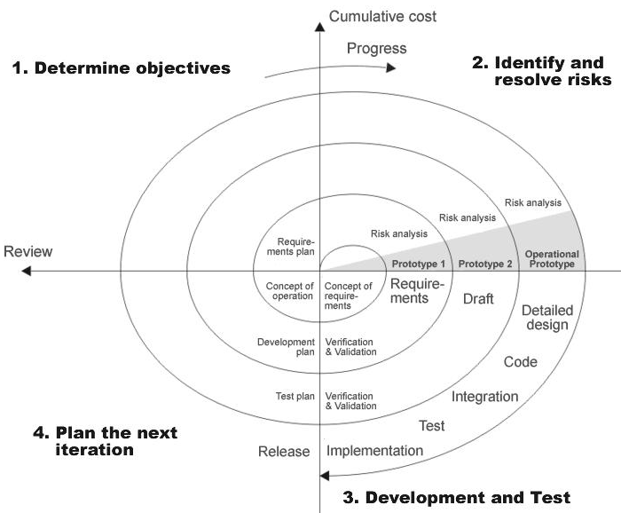
THE FOLLOWING DIAGRAM SHOWS HOW A SPIRAL MODEL ACTS LIKE:

Slide 27
ADVANTAGES OF SPIRAL MODEL:
Estimates(i.e. budget, schedule etc .) become more realistic as work progresses, because important issues discovered earlier.
It is more able to cope with the changes that are software development generally entails.
Software engineers can get their hands in and start working on the core of a project earlier.

Slide 28
E-R DIAGRAM

Slide 30
UML DIAGRAMS

Slide 31
The Unified Modeling Language allows the software engineer to express an analysis model using the modeling notation that is governed by a set of syntactic semantic and pragmatic rules.
A UML system is represented using five different views that describe the system from distinctly different perspective. Each view is defined by a set of diagram, which is as follows.
User Model View.
Structural Model View.
Behavioral Model View.
Implement Model View.
Environmental Model View.
UML is specifically constructed through two different domains they are:
UML Analysis modeling, this focuses on the user model and structural model views of the system.
UML design modeling, which focuses on the behavioral modeling, implementation modeling and environmental model views.

Slide 32
CLASS COLLABORATION DIAGRAM

Slide 34
USE CASE DIAGRAMS

Slide 35
System Use Case Diagrams

Slide 36
ADMINISTRATOR

Slide 37
SEQUENCE DIAGRAMS

Slide 38
Administrator Sequence Diagram

Slide 39
User Sequence Diagram

Slide 40
COLLABORATION DIAGRAM

Slide 43
ACTIVITY DIAGRAMS

Slide 44
Administrator Activity Diagram

Slide 45
CUSTOMER:

Slide 46
COMPONENT DIAGRAM

Slide 47
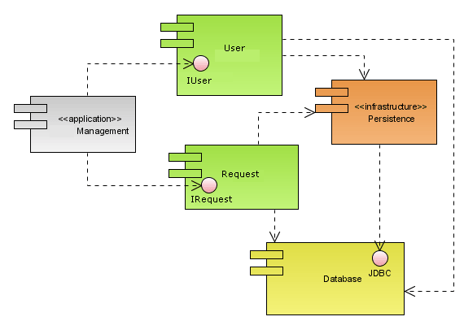

Slide 48
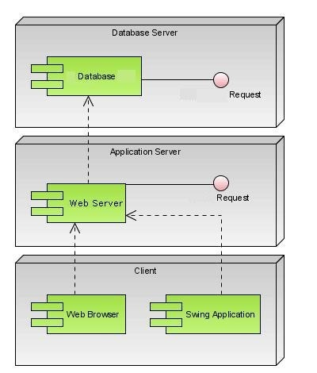

Slide 49
DEPLOYMENT DIAGRAM

Slide 50
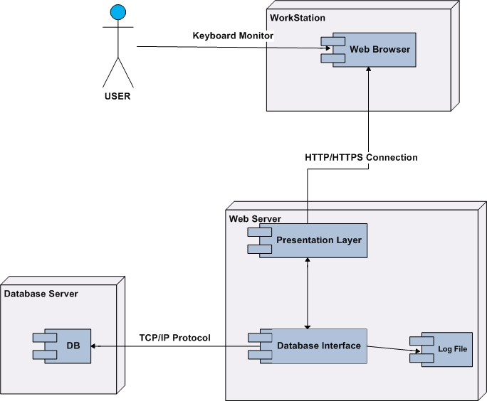

Slide 51
OUTPUT SCREENS

Slide 52
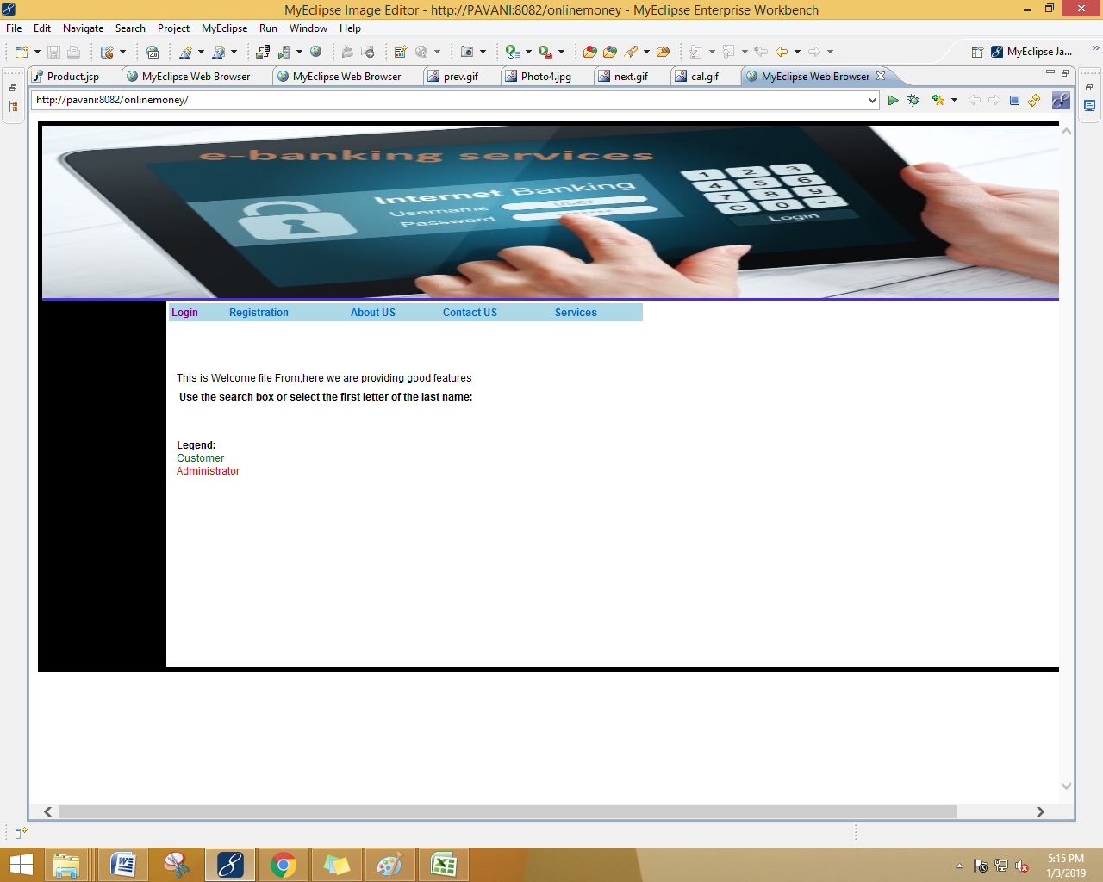

Slide 53
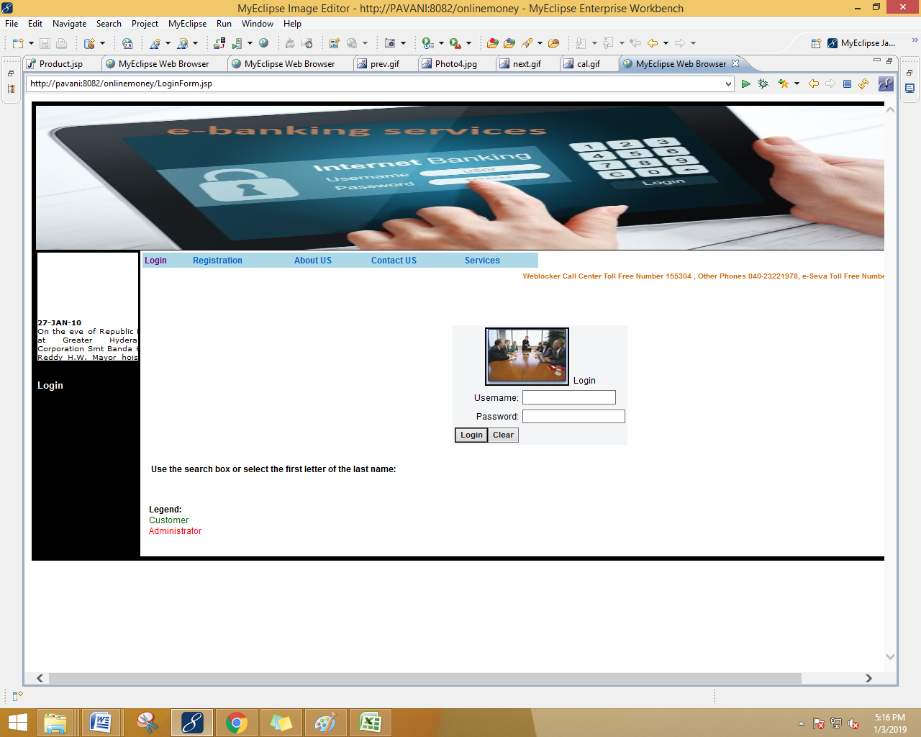

Slide 54


Slide 55
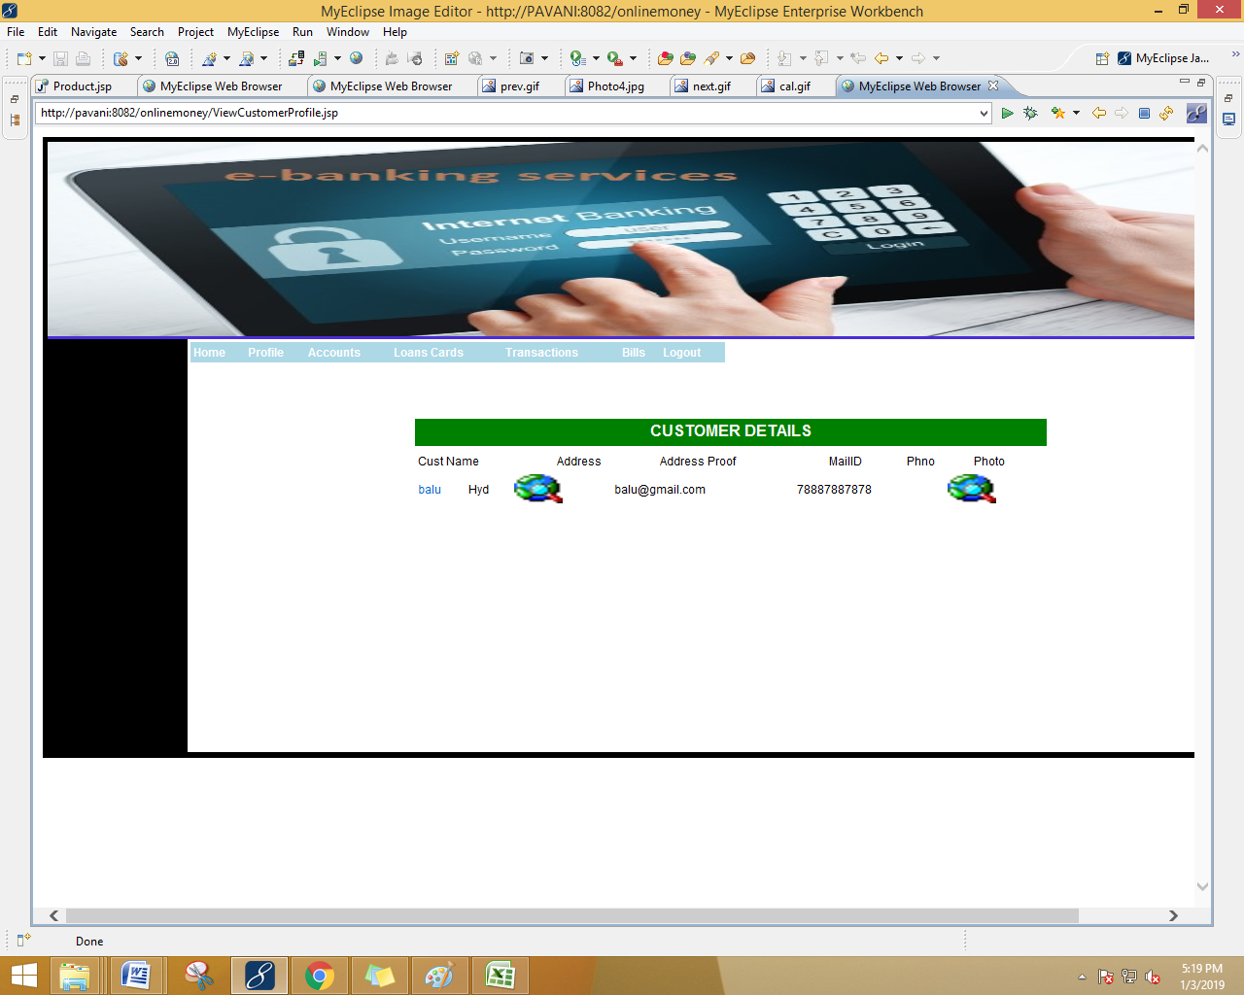

Slide 56


Slide 57


Slide 58
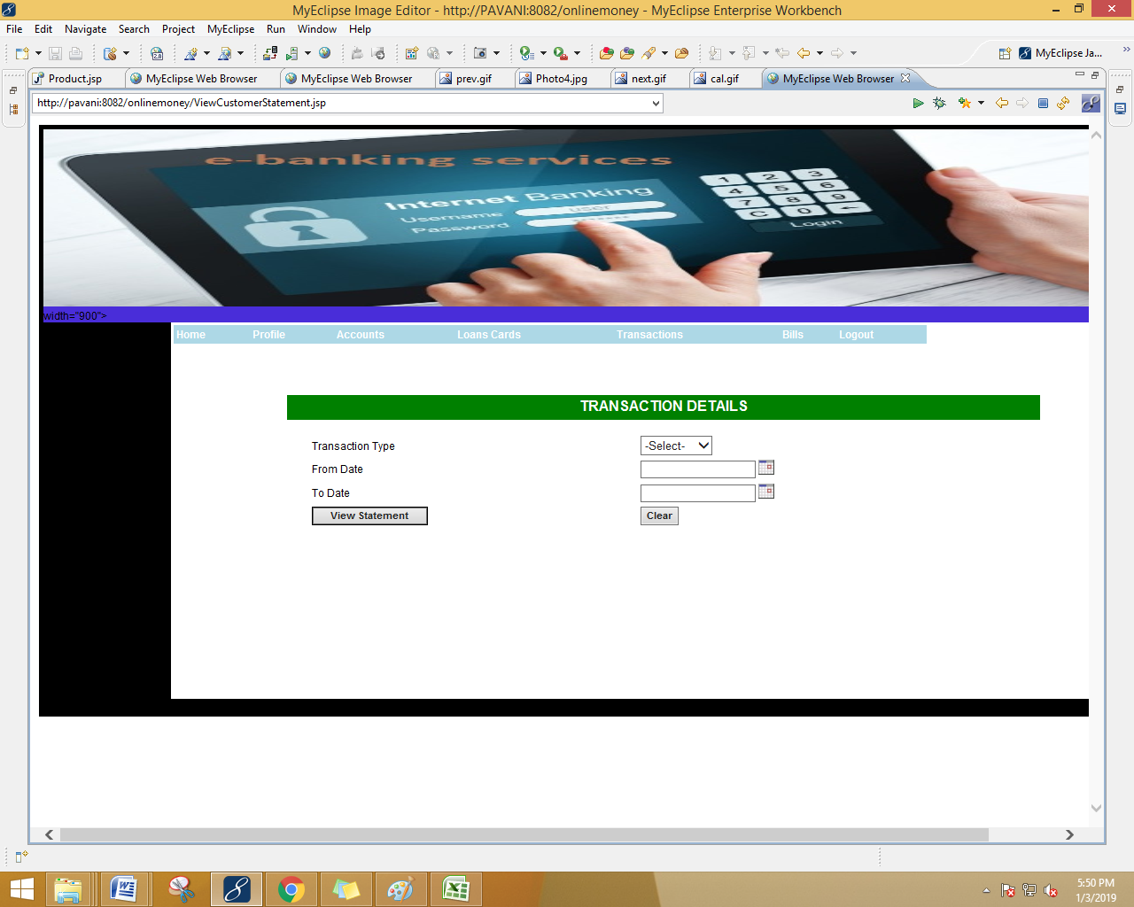

Slide 59


Slide 60
THANK YOU

